Slide 1
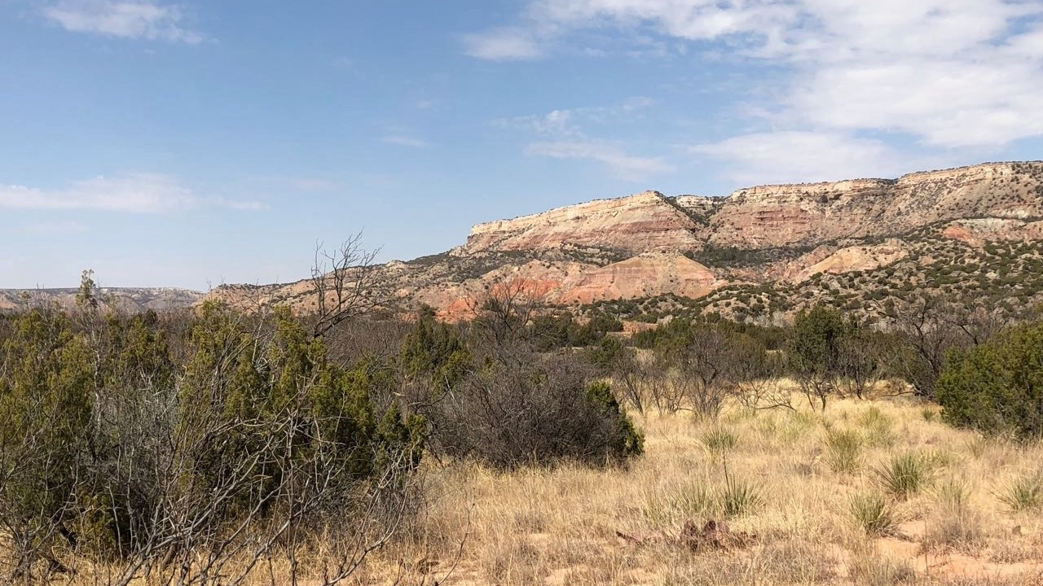
Resilience of West Texas Flora
Nick Smith
Biological Sciences, TTU
nick.smith@ttu.edu; @nick_greg_smith

Slide 2
For plants, the West Texas climate can be challenging…
nick.smith@ttu.edu; @nick_greg_smith

Slide 3
It’s hot!
nick.smith@ttu.edu; @nick_greg_smith

Slide 4
And can get really hot!
nick.smith@ttu.edu; @nick_greg_smith

Slide 5
Plants don’t always love heat
nick.smith@ttu.edu; @nick_greg_smith

Slide 6
And it’s only going to get hotter!
nick.smith@ttu.edu; @nick_greg_smith

Slide 7
It also doesn’t rain a lot!
nick.smith@ttu.edu; @nick_greg_smith

Slide 8
This has been on display in recent years
nick.smith@ttu.edu; @nick_greg_smith

Slide 9
Plants try to save water when it’s unavailable
nick.smith@ttu.edu; @nick_greg_smith
Wet
Dry

Slide 10
Hot and Dry is a bad combination!
nick.smith@ttu.edu; @nick_greg_smith
5
Wet
2
Rel. Photosynthesis (µmol m⁻² s⁻¹)
Dry
1
Temperature (°C)
Smith & Dukes (2018). Ecology.

Slide 11
A reason for optimism: adaptations
nick.smith@ttu.edu; @nick_greg_smith

Slide 12
A reason for optimism: adaptations
nick.smith@ttu.edu; @nick_greg_smith
The plants here are adapted to live and compete in this harsh environment

Slide 13
A reason for optimism: adaptations
nick.smith@ttu.edu; @nick_greg_smith
These adaptations come in many flavors and are a major characteristic of some key players in the ecosystem…

Slide 14
Chino grama (Bouteloua ramosa)
nick.smith@ttu.edu; @nick_greg_smith
Adaptation: C4 photosynthesis
Images: Ladybird Johnson wildflower center

Slide 15
Chino grama (Bouteloua ramosa)
nick.smith@ttu.edu; @nick_greg_smith
Adaptation: C4 photosynthesis
Photosynthesis
Images: Ladybird Johnson wildflower center
Long et al., (2006). PC&E.

Slide 16
Chino grama (Bouteloua ramosa)
nick.smith@ttu.edu; @nick_greg_smith
Adaptation: C4 photosynthesis
Images: Ladybird Johnson wildflower center
Taiz et al. (2015)

Slide 17
Chino grama (Bouteloua ramosa)
nick.smith@ttu.edu; @nick_greg_smith
Adaptation: C4 photosynthesis
Cost: Need an extra step in photosynthesis
Benefit: Can keep stomata less open, don’t lose as much water when it’s hot and dry
Images: Ladybird Johnson wildflower center

Slide 18
Big bend prickly pear (Opuntia azurea)
nick.smith@ttu.edu; @nick_greg_smith
Adaptation: CAM photosynthesis
Image: NPS

Slide 19
Big bend prickly pear (Opuntia azurea)
nick.smith@ttu.edu; @nick_greg_smith
Adaptation: CAM photosynthesis
Image: NPS
Nobel & Hartsock (1983). Plant Phys.

Slide 20
Big bend prickly pear (Opuntia azurea)
nick.smith@ttu.edu; @nick_greg_smith
Adaptation: CAM photosynthesis
Cost: Need an extra step in photosynthesis; need to store CO2
Benefit: Can keep stomata closed during day, don’t lose as much water when it’s hot and dry
Image: NPS

Slide 21
Big bend bluebonnet (Lupinus havradii)
nick.smith@ttu.edu; @nick_greg_smith
Adaptation: Biological Nitrogen Fixation
Images: Ladybird Johnson wildflower center

Slide 22
Big bend bluebonnet (Lupinus havradii)
nick.smith@ttu.edu; @nick_greg_smith
Adaptation: Biological Nitrogen Fixation
Images: Ladybird Johnson wildflower center

Slide 23
Big bend bluebonnet (Lupinus havradii)
nick.smith@ttu.edu; @nick_greg_smith
Adaptation: Biological Nitrogen Fixation
Liao et al. (2017). Global Change Biology

Slide 24
Big bend bluebonnet (Lupinus havradii)
nick.smith@ttu.edu; @nick_greg_smith
Adaptation: Biological Nitrogen Fixation
Cost: Gotta feed the bacteria
Benefit: Don’t need to worry about getting N; can worry about getting and keeping water in dry environments

Slide 25
A reason for optimism: acclimation
nick.smith@ttu.edu; @nick_greg_smith

Slide 26
A reason for optimism: acclimation
nick.smith@ttu.edu; @nick_greg_smith
All plants have a strong capacity to acclimate to changes in their environmental conditions

Slide 27
nick.smith@ttu.edu; @nick_greg_smith
Dumb plants

Slide 28
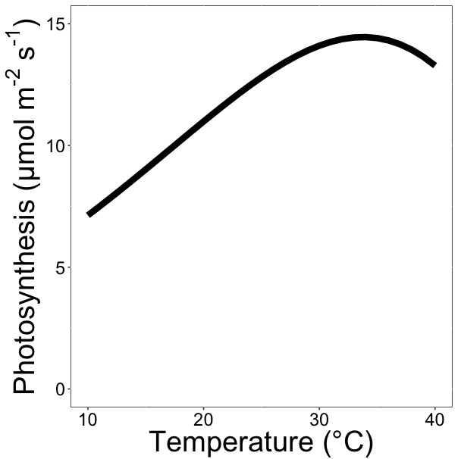
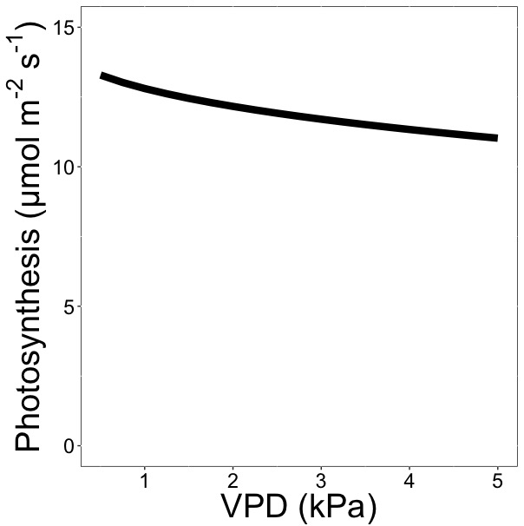
nick.smith@ttu.edu; @nick_greg_smith
Wet
Dry

Slide 29

nick.smith@ttu.edu; @nick_greg_smith
Observed Photosynthesis
Wet
Dry
Predicted Photosynthesis
Smith et al. (2019). Ecology Letters.

Slide 30
nick.smith@ttu.edu; @nick_greg_smith
What’s this mean for future Big Bend plants?
Wet
Dry

Slide 31
nick.smith@ttu.edu; @nick_greg_smith
What’s this mean for future Big Bend plants?
+5°C temperature = 2% increase in photosynthesis
Wet
Dry

Slide 32
nick.smith@ttu.edu; @nick_greg_smith
What’s this mean for future Big Bend plants?
+5°C temperature = 2% increase in photosynthesis
+1.5 kPa VPD = 4% decrease in photosynthesis
Wet
Dry

Slide 33
A reason for optimism: elevated CO₂
nick.smith@ttu.edu; @nick_greg_smith

Slide 34
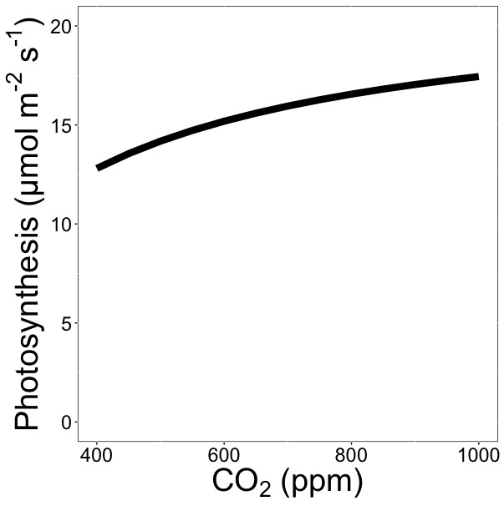
A reason for optimism: elevated CO₂
nick.smith@ttu.edu; @nick_greg_smith
What’s this mean for future Big Bend plants?
+400 ppm CO2 = 29% increase in photosynthesis

Slide 35
A reason for optimism: elevated CO₂
nick.smith@ttu.edu; @nick_greg_smith
What’s this mean for future Big Bend plants?
+400 ppm CO2 = 29% increase in photosynthesis
2% decrease in water use
23% decrease in nitrogen use

Slide 36
At the individual level, Big Bend plants are likely to be resilient to climate change
nick.smith@ttu.edu; @nick_greg_smith
Numerous adaptations to heat and low moisture
High acclimation capacity
Elevated CO₂ is likely to alleviate any negative impacts of climate change

Slide 37
Reasons for pessimism: effects at higher levels of operation
nick.smith@ttu.edu; @nick_greg_smith
Physio-logical Ecology
Population Ecology
Community Ecology
Ecosystem Ecology

Slide 38
Plant community responses and invasion
nick.smith@ttu.edu; @nick_greg_smith
Exotic invaders (e.g., buffelgrass)
Native invaders (e.g., mesquite)

Slide 39
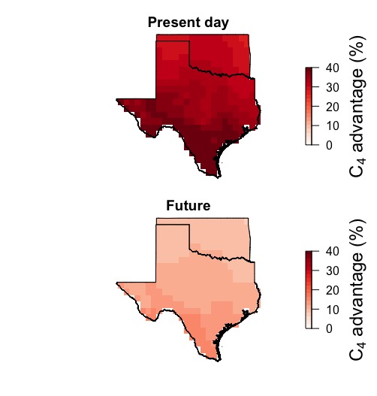
Likely to see more C₃ species in the future (e.g., mesquite)…
nick.smith@ttu.edu; @nick_greg_smith
Native invaders (e.g., mesquite)
Ansley et al. (in prep).

Slide 40
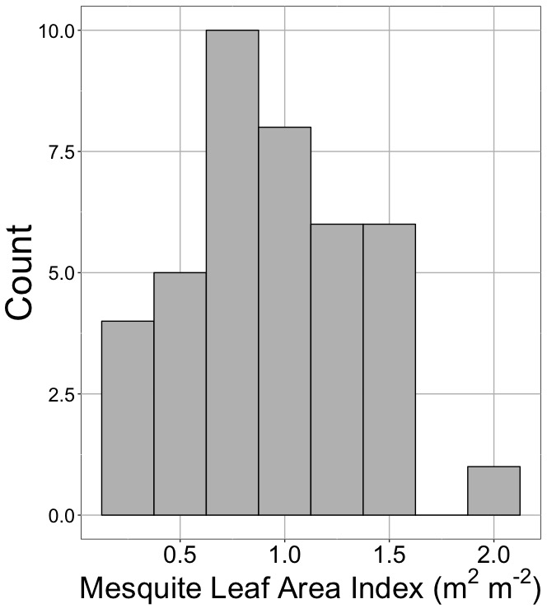
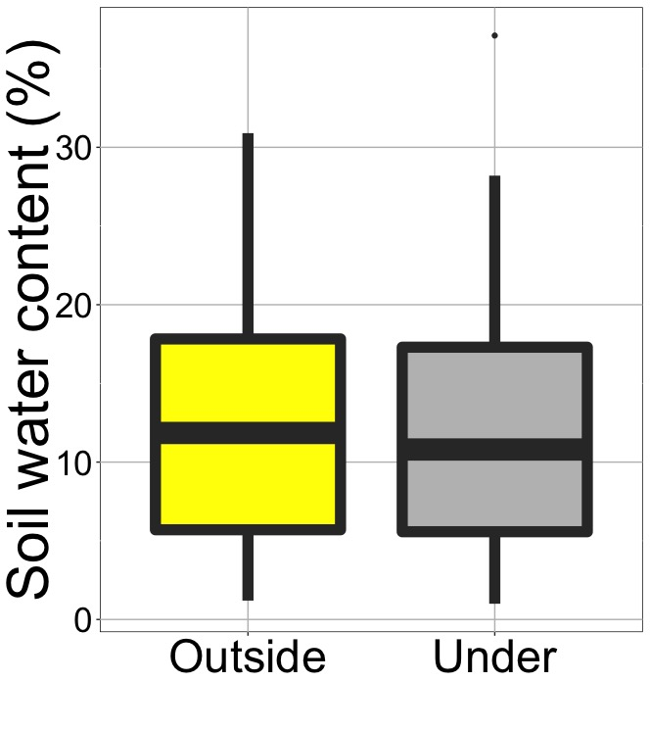
…which could impact microclimate…
P < 0.05
Smith and Ortiz (in prep)

Slide 41
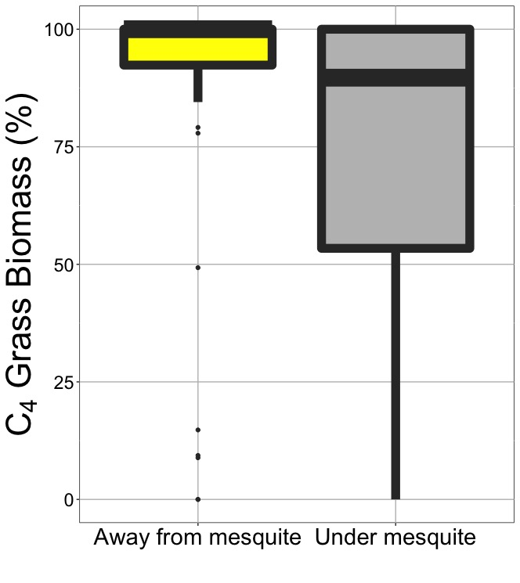
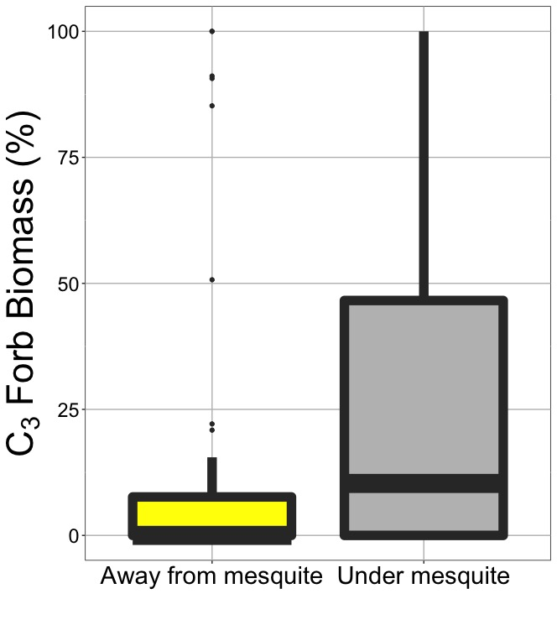
…which could impact other species
nick.smith@ttu.edu; @nick_greg_smith
Smith and Ortiz (in prep)

Slide 42
Indirect effects
nick.smith@ttu.edu; @nick_greg_smith
Fire
Phenological mismatches
Pests
Others?
Image: NPS

Slide 43
Take home
nick.smith@ttu.edu; @nick_greg_smith
Big Bend species are likely to be resilient to climate change at the individual level
Impacts are likely to be indirect and the result of higher level processes

Slide 44
Take home
nick.smith@ttu.edu; @nick_greg_smith
Big Bend species are likely to be resilient to climate change at the individual level
Impacts are likely to be indirect and the result of higher level processes
Good news: some can be managed
Image: NPS

Slide 45
nick.smith@ttu.edu; @nick_greg_smith
Questions?
Contact:
nick.smith@ttu.edu
Presentation:
github.com/smithecophyslab/seminar/bigbend_2020

